Slide 1
Quadtrees – Hierarchical Grids

Slide 2
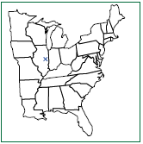
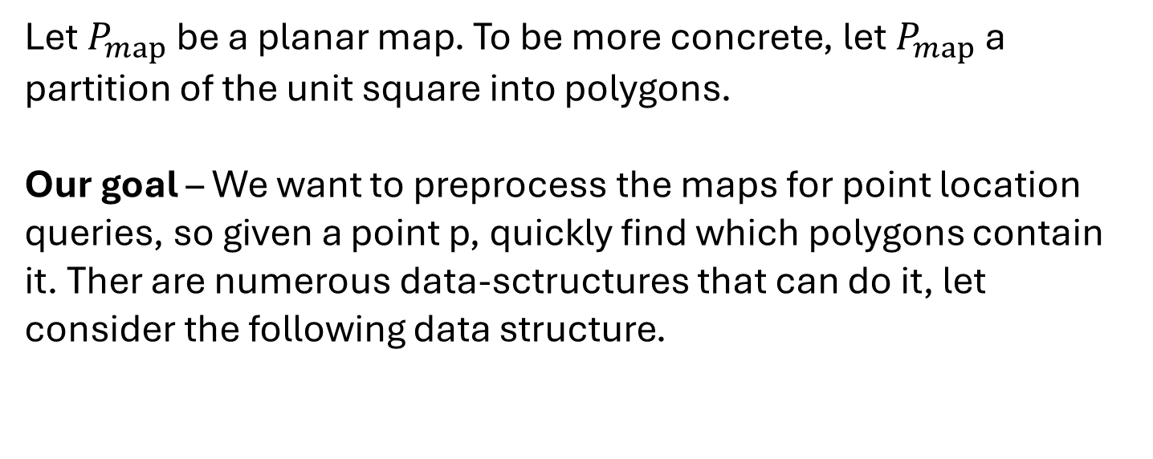
Background…
Let $P_{map}$ be a planar map. To be more concrete, let $P_{map}$ a partition of the unit square into polygons.
Our goal – We want to preprocess the maps for point location queries, so given a point p, quickly find which polygons contain it. Ther are numerous data-sctructures that can do it, let consider the following data structure.

Slide 3
What are Quadtrees?
A Quadtree, is a simple yet powerful geometric data-structure for representing planar maps. It is particularly useful for point-location queries, where we want to determine which region or polygon contains a given query point.

Slide 4
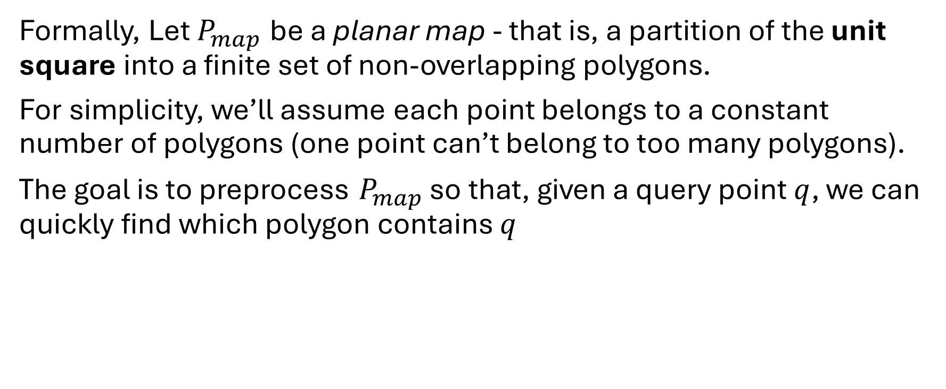
The Point-Location Problem
Formally, Let $P_{map}$ be a planar map - that is, a partition of the unit square into a finite set of non-overlapping polygons.
For simplicity, we’ll assume each point belongs to a constant number of polygons (one point can’t belong to too many polygons).
The goal is to preprocess $P_{map}$ so that, given a query point $q$, we can quickly find which polygon contains $q$

Slide 5
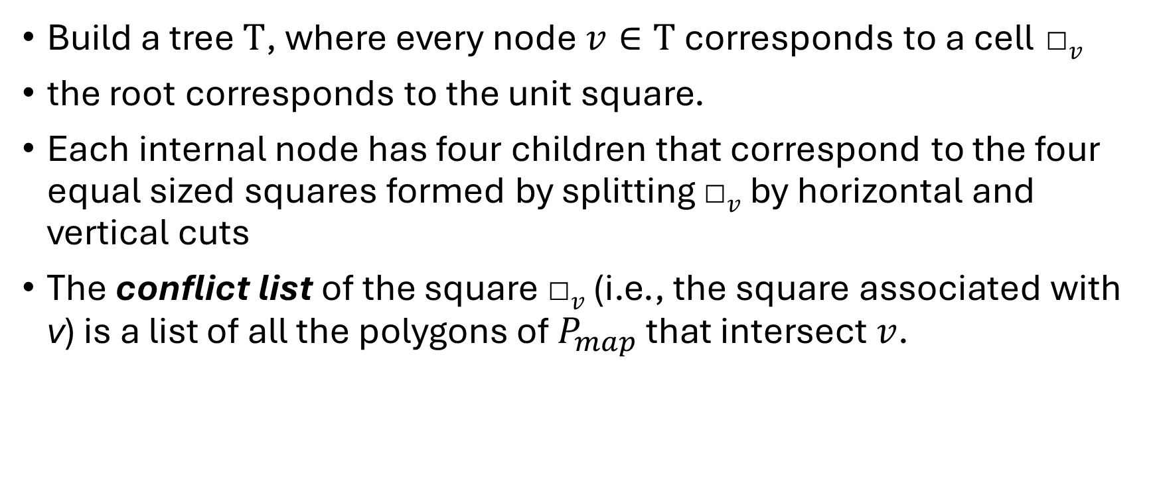
The Simple Solution - Construction
Build a tree $T$, where every node $v∈T$ corresponds to a cell □$v$
the root corresponds to the unit square.
Each internal node has four children that correspond to the four equal sized squares formed by splitting □$v$ by horizontal and vertical cuts
The conflict list of the square □$v$ (i.e., the square associated with v) is a list of all the polygons of $P_{map}$ that intersect $v$.

Slide 6
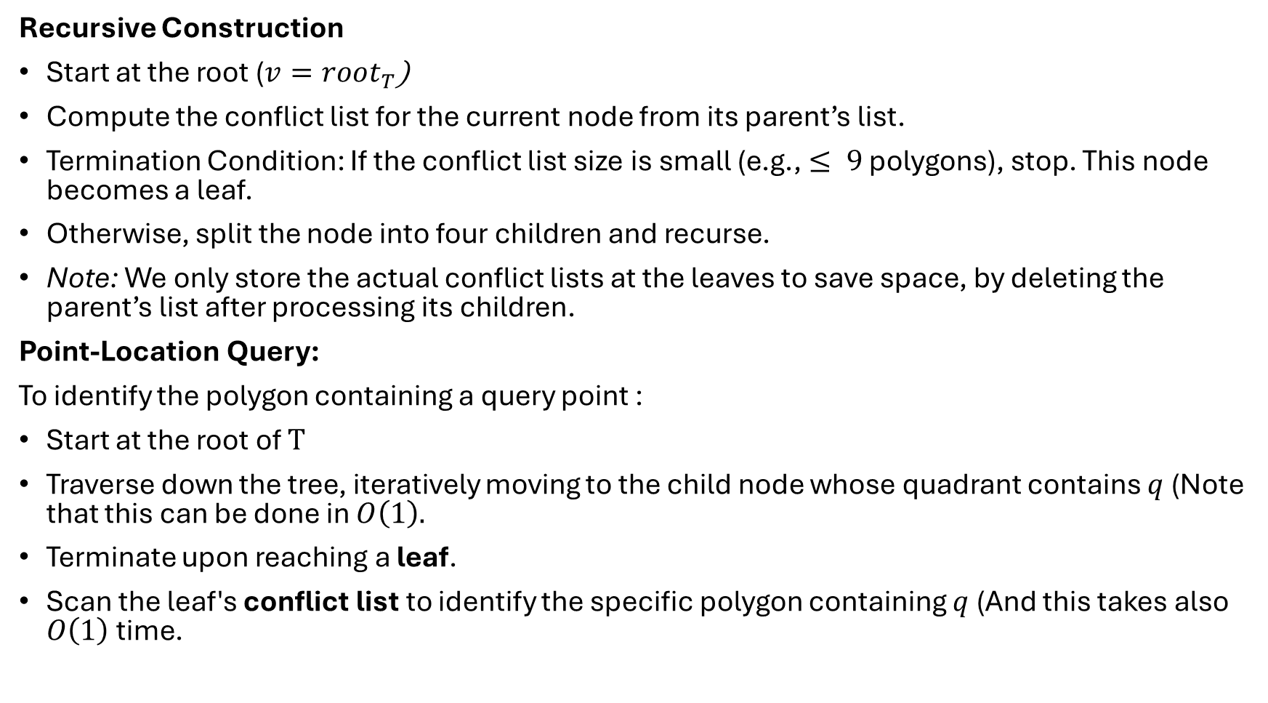
Recursive Construction
Start at the root ($v=root_{T}$)
Compute the conflict list for the current node from its parent’s list.
Termination Condition: If the conflict list size is small (e.g., $≤ 9$ polygons), stop. This node becomes a leaf.
Otherwise, split the node into four children and recurse.
Note: We only store the actual conflict lists at the leaves to save space, by deleting the parent’s list after processing its children.
Point-Location Query:
To identify the polygon containing a query point :
Start at the root of $T$
Traverse down the tree, iteratively moving to the child node whose quadrant contains $q$ (Note that this can be done in $O\left(1\right).$
Terminate upon reaching a leaf.
Scan the leaf's conflict list to identify the specific polygon containing $q$ (And this takes also $O\left(1\right)$ time.

Slide 7
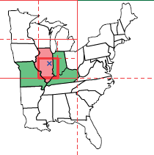
Space Complexity Analysis:
Worst Case: If polygons are "long and skinny," they may intersect many squares without being fully contained. This can lead to a tree of unbounded depth and complexity.
reasonable Input: - for reasonable inputs, the complexity of the quadtree will be linear in the size of the input (a proof for fat triangles polygons is shown at the end)

Slide 8

Fast point-location query in a quadtree
An algorithm for fast query in regular quadtree:
Definition - A square is a canonical square if it is contained inside the unit square; it is a cell in a grid $G_{r}$ and $r$ is a power of two (i.e., it might correspond to a node in a quadtree). We will refer to such a grid $G_{r}$ as a canonical grid.

